Slide 1
Lecture 12: Minimization of DFA
Agenda:
DFA Minimization Rules
Example of DFA Minimization
Presented by
Prof. Vaibhav Narayan Chunekar
K. J. Somaiya College of Engineering, Vidyavihar, Mumbai

Slide 2
Minimized DFA
Minimization of DFA is required to obtain the minimal version of DFA which consist of the minimum numbers of state possible.
DFA 5 States → 4 states by merging any two state without changing the meaning of DFA
When to merge two states?
➔ Equivalent States

Slide 3
Methods of DFA Minimization
State Equivalence Method
My Hill Nerode Theorem( Table Filling Method)

Slide 4
State Equivalence Method
If X and Y are two states in a DFA, we can combine these two states into {X, Y} if they are not distinguishable.
Two states are distinguishable, if there is at least one string S, such that one of δ (X, S) and δ (Y, S) is accepting and another is not accepting.
Hence, a DFA is minimal if and only if all the states are distinguishable.

Slide 5
Algorithm
Step 1 − All the states Q are divided in two partitions − final states and non-final states and are denoted by P₀. All the states in a partition are 0th equivalent. Take a counter k and initialize it with 0.
Step 2 − Increment k by 1. For each partition in P_{k}, divide the states in P_{k} into two partitions if they are k-distinguishable. Two states within this partition X and Y are k-distinguishable if there is an input S such that δ(X, S) and δ(Y, S) are (k-1)-distinguishable.
Step 3 − If P_{k} ≠ P_{k-1}, repeat Step 2, otherwise go to Step 4.
Step 4 − Combine k^{th} equivalent sets and make them the new states of the reduced DFA.

Slide 6
DFA Minimization Rules:
For reducing equivalent state to a single state one should follow the following rules:
We can replace one non final state by its equivalent non final state only
We can replace one final state with its equivalent final state only
We cannot delete initial state.
We cannot replace one final state by its non final state or non final state by final state
Replace state A by state B meaning deleting all entries related to state A from transition table. Whenever we find A we replace with B.
We repeat the above steps until equivalence states are found. After getting two consecutive rows of equivalent state we stop the process.

Slide 7
Minimization DFA Rules:
When we say that two states are equivalent?
Two states let it be ‘A’ and ‘B’ are said to be equivalent if –
δ( A,x)→ F and δ(B,x)→ F
δ( A,x)≠ F and δ(B,x) ≠ F
where x is input string
If |x|= 0 then A and B are said to be 0 equivalent.
If |x|= 1 then A and B are said to be 1 equivalent.
If |x|= 2 then A and B are said to be 2 equivalent.
......
If |x|= n then A and B are said to be n equivalent.

Slide 8
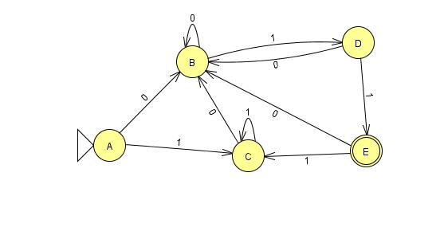
Example 1: Minimized the following DFA using Method 1.
Q Σ | 0 | 1
→A | B | C
B | B | D
C | B | C
D | B | E
* E | B | C

Slide 9
State Equivalence Method
0 equivalence : { A,B,C,D}{E}
1 equivalence : { A,B,C} {D}{E}
2 equivalence : { A,C} {B} {D}{E}
3 equivalence : { A,C} {B} {D}{E}
Stopping Condition: When two rows are consecutively giving same result then end the process.
Q Σ | 0 | 1
→A | B | C
B | B | D
C | B | C
D | B | E
* E | B | C

Slide 10
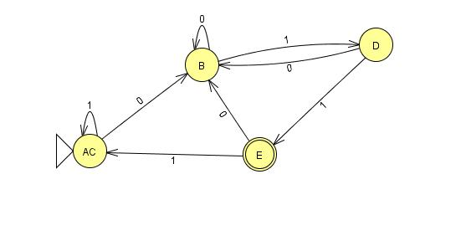
Minimized DFA:
Q Σ | 0 | 1
→A C | B | C
B | B | D
C | B | C
D | B | E
* E | B | C
Q Σ | 0 | 1
→AC | B | AC
B | B | D
D | B | E
* E | B | AC

Slide 11
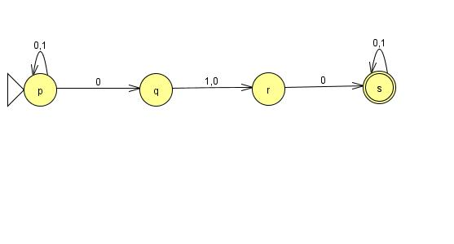
Example 2 : w ∈{0,1}*| w accept the string 000 or 010. Convert this language to NFA then DFA and follows with minimized DFA
NFA:
Q Σ | 0 | 1
→p | p,q | p
q | r | r
r | s | -
*s | s | s

Slide 12
Power Set 2 ^{Q}
Q’= {p,q,r,s,pq,pr,ps,qr,qs,rs,pqr,pqs,prs,qrs,pqrs}
F’= { s,ps,qs,rs,pqs,prs,qrs,pqrs}
δ ‘(p,0)= pq, δ ‘(p,1)= p; δ ‘(q,0)= r , δ ‘(q,1)= r;...........
δ ‘(pqr,0)={δ (p,0) U δ (q,0) δ (r,0) }={ { pq} U{r}U {s}} ={ pqrs}
indicate Start state
* Indicate Final State
According to this final state transition table are as follows:

Slide 13
State Transition Table
Rename State | Q Σ | Rename State 0 | Rename State 1
1 | →p | p,q(5) | P(1)
2 | q | r(3) | R(3)
3 | r | *S(4) | -
4 | *s | *S(4) | *S(4)
5 | pq | Pqr(11) | Pr(6)
6 | pr | *Pqs(12) | P(1)
7 | *ps | *Pqs(12) | *Ps(7)
8 | qr | *Rs(10) | R(3)
9 | *qs | *Rs(10) | *Rs(10)
10 | *rs | *S(4) | *S(4)
11 | Pqr | *Pqrs(15) | Pr(6)
12 | *pqs | *Pqrs(15) | *Prs(13)
13 | *prs | *Pqs(12) | *Ps(7)
14 | *qrs | *Rs(10) | *Rs(10)
15 | *pqrs | *Pqrs(15) | *Prs(13)

Slide 14
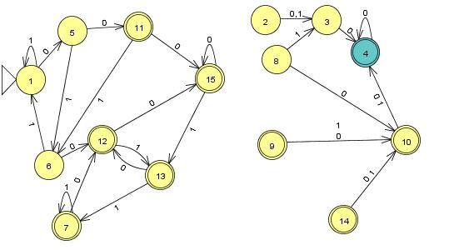
DFA(15 states):

Slide 15
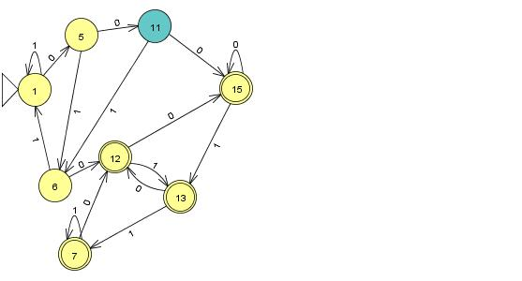
Remove the Unreachable State

Slide 16
0 equivalence
Q={1,5,6,7,11,12,13,15 }
Set of Non Final State:
{1,5,6,11}
Set of final State:
{7,12,13,15,}

Slide 17
Minimized State Transition table
Q Σ | 0 | 1
1 | 5 | 1
5 | 11 | 6
6 | *12 | 1
*7 | *12 | *7
11 | *15 | 6
*12 | *15 | *13
*13 | *12 | *7
*15 | *15 | *13

Slide 18
1 equivalence
{1,5,6,11}
={ 1,5} {6,11}
{7,12,13,15}
={{7,12,13,15}

Slide 19
Minimized State Transition table
Q Σ | 0 | 1
1 | 5 | 1
5 | 11 | 6
6 | 12 | 1
*7 | 12 | 7
11 | 15 | 6
*12 | 15 | 13
*13 | 12 | 7
*15 | 15 | 13

Slide 20
2 equivalence
{1,5,6,11}
={ 1,5} {6}{11}
{7,12,13,15}
={{7,12,13,15}

Slide 21
3 equivalence
{1,5,6,11}
={ 1}{5} {6}{11}
{7,12,13,15}
={{7,12,13,15}

Slide 22
4 equivalence
{1,5,6,11}
={ 1}{5} {6}{11}
{7,12,13,15}
={{7,12,13,15}

Slide 23
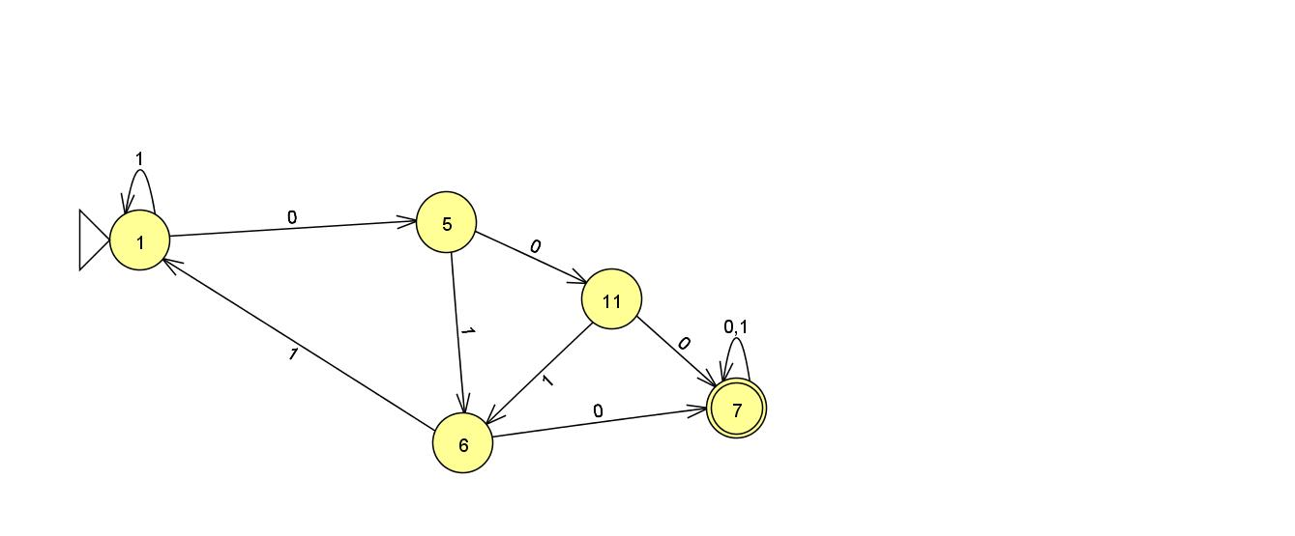
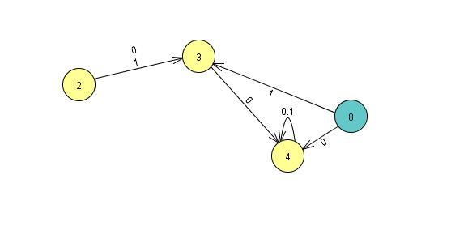
DFA

Slide 24
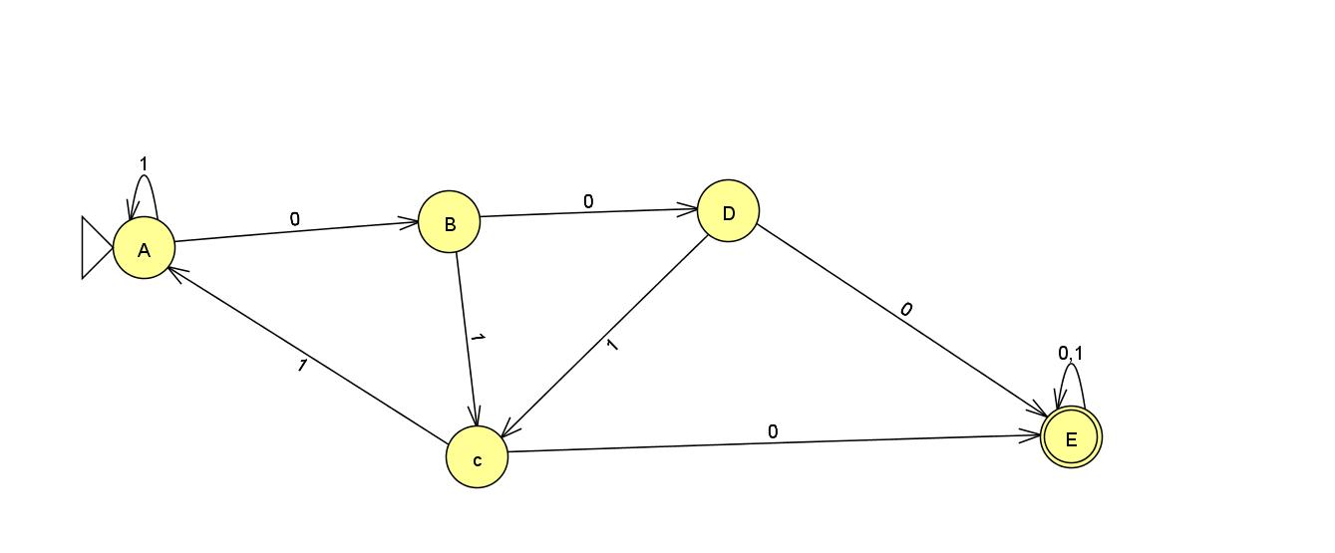
Final DFA

Slide 25
Thanks !!!!
Any Query???

